Slide 1
ELECTRIC VEHICLES SALE BY STATES
BY MADHUMITA PATRO

Slide 2
About Dataset
This dataset is valuable for analysts, data scientists, and researchers aiming to
understand electric vehicle (EV) adoption trends across India. It is versatile and ideal
for geographic market segmentation, trend analysis, and predictive modeling. By
offering insights into regional EV sales patterns, the dataset supports strategic
decision-making in market planning and infrastructure investment.
The data was meticulously scraped from the Clean Mobility Shift website, and then
thoroughly preprocessed to ensure accuracy and relevance. All null values have been
removed, and the dataset has been cleaned to prepare it for immediate use in
exploration, visualization, and analytical projects. It is particularly valuable for market
trend analysis, infrastructure planning, and policy development within the EV sector.

Slide 3
Included Files:
EV_Dataset.csv: Contains state-level data on EV sales, including vehicle types and
categories, offering a comprehensive view of EV distribution across Indian states.
Key Features:
State: Names of Indian states with recorded EV sales data.
Vehicle Type: Classifications of vehicles, such as two-wheelers and four-wheelers.
Vehicle Category: Further classification into segments like commercial and passenger
vehicles.
Electric_Vehicle_Sales_Quantity: The number of EVs sold per state, essential for
analyzing adoption trends.

Slide 4
Electric Vehicle Sales by State in India:
This project aims to analyze and predict the sales of Electric Vehicles (EV) by state in
India using machine learning. The dataset contains the following columns:
● Year: The year of the sales.
● Month_Name: The month in which sales occurred.
● Date: The specific date of the sales.
● State: The state in India where the sales occurred.
● Vehicle_Class: The class of the vehicle (e.g., sedan, SUV, etc.).
● Vehicle_Category: The category of the vehicle (e.g., commercial, passenger).
● Vehicle_Type: The type of the vehicle (e.g., 2-wheeler, 4-wheeler).
● EV_Sales_Quantity: The quantity of EV sales.

Slide 5
Steps Involved
1. Data Collection: Load and inspect the dataset.
2. Data Preprocessing: Handle missing values, convert date formats, and
perform feature engineering.
3. Exploratory Data Analysis (EDA): Visualize trends and relationships between
variables.
4. Feature Engineering: Create new features from the date column and encode
categorical variables.
5. Modeling: Build a regression model to predict EV sales.
6. Evaluation: Evaluate the model performance and interpret the results.
7. Visualization: Visualize the results and trends using graphs and charts.

Slide 6
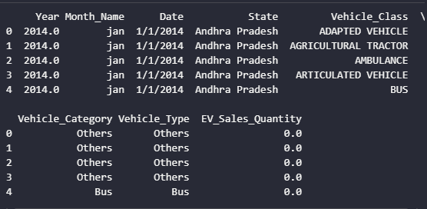

Slide 7
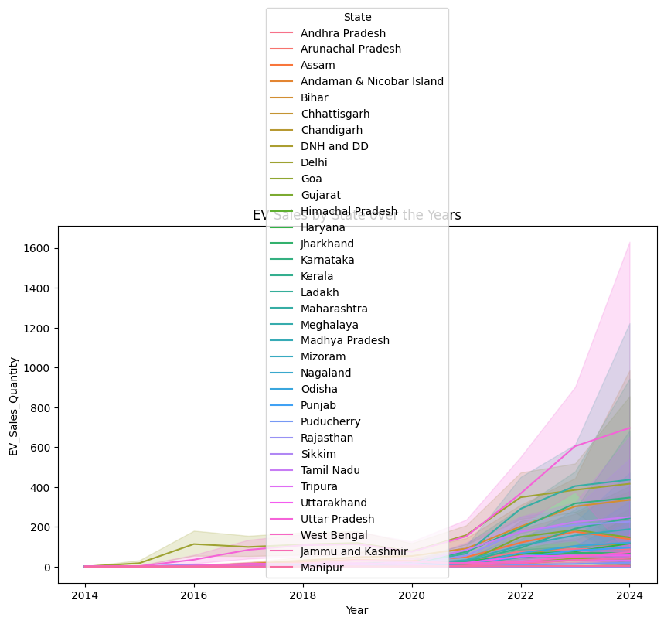

Slide 8
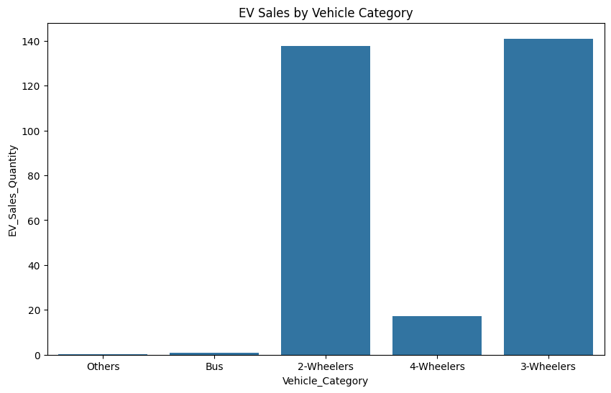

Slide 9
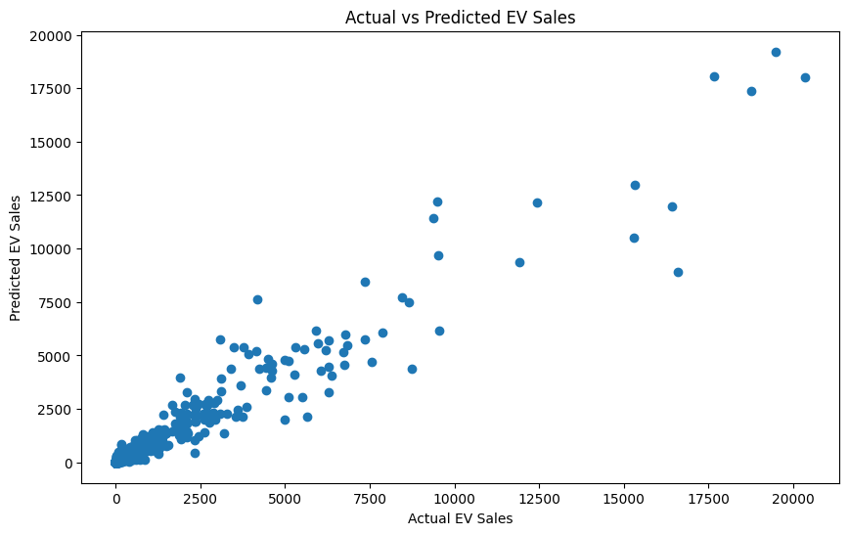

Slide 10
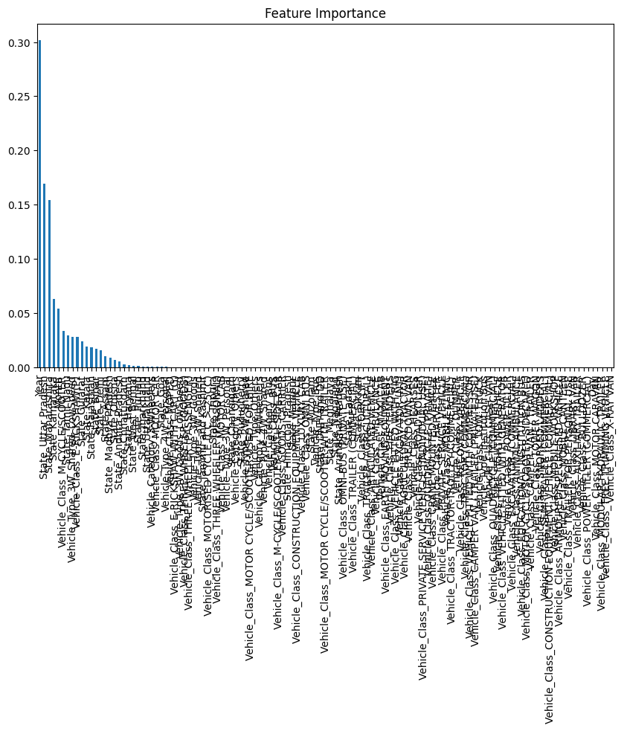

Slide 11
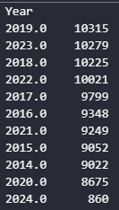

Slide 12
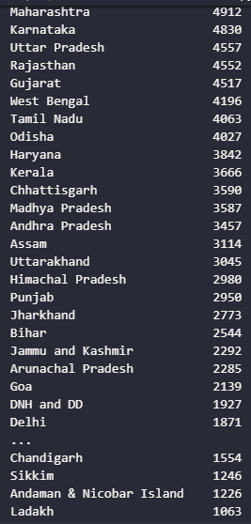

Slide 13
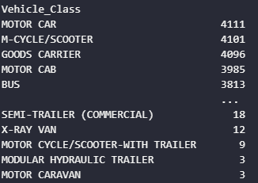

Slide 14
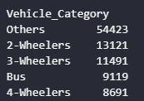

Slide 15
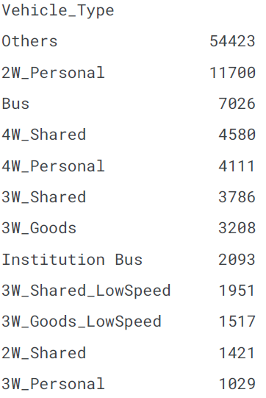

Slide 16
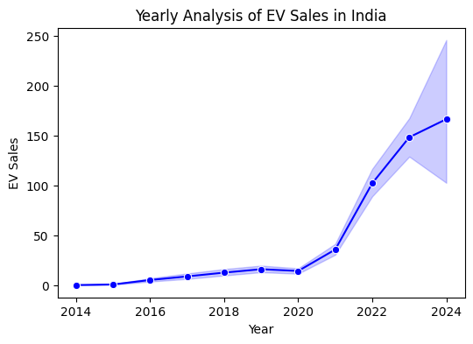

Slide 17
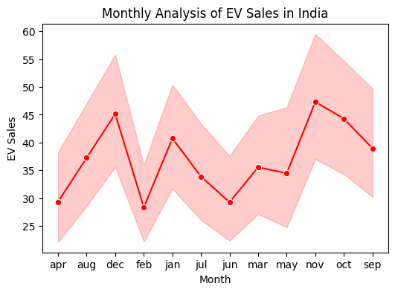

Slide 18
